Slide 1
Online Book Store Website
Presented by
Sharia Wasika Aditi(1607109)

Slide 2
Features
Discover huge collection of books
Order books online
See trending books
User login and registration
User can give feedback about the website
Admin can control the database

Slide 3
INTERFACES

Slide 4

Front page

Slide 5

Home Page

Slide 6
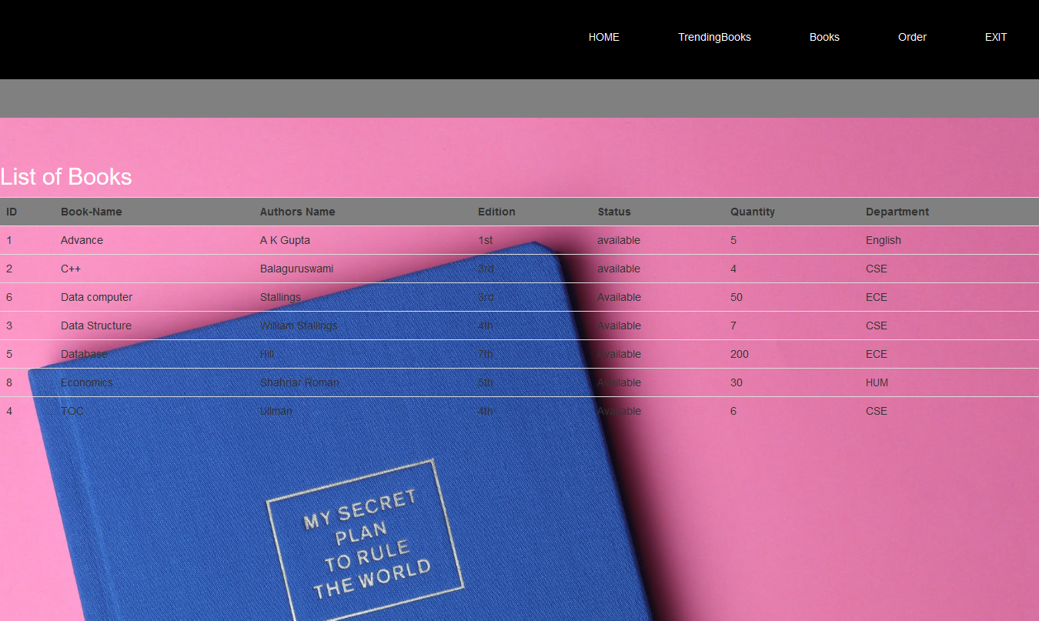
Book List

Slide 7
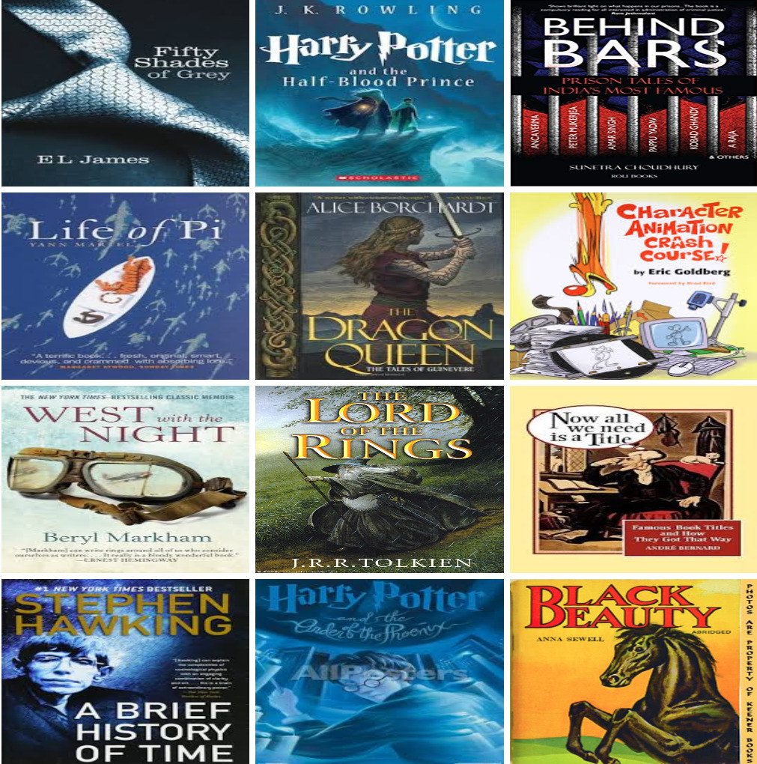
Gallery of books

Slide 8

Author wise book list

Slide 9
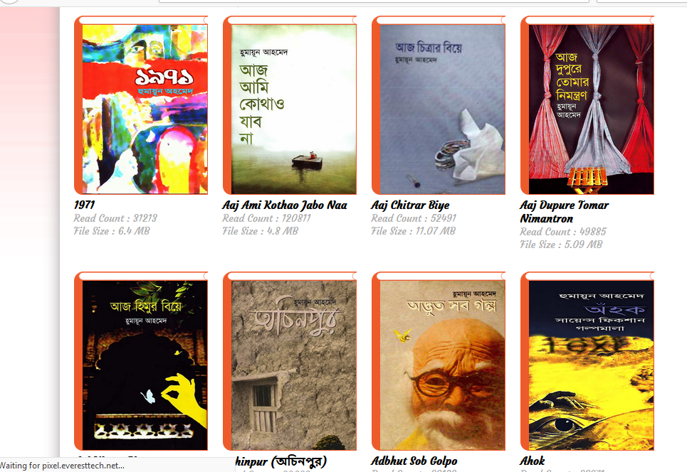
Humayun Ahmed books

Slide 10

Zafar Iqbal Books

Slide 11
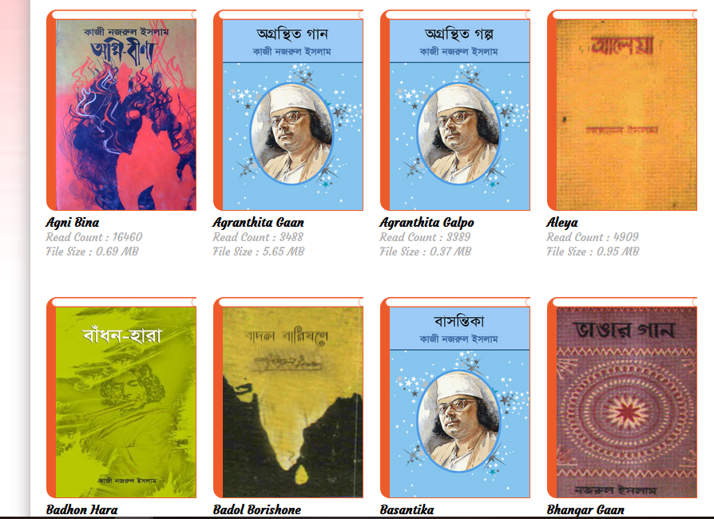
Kazi Nazrul Islam books

Slide 12
USER INTERFACES

Slide 13
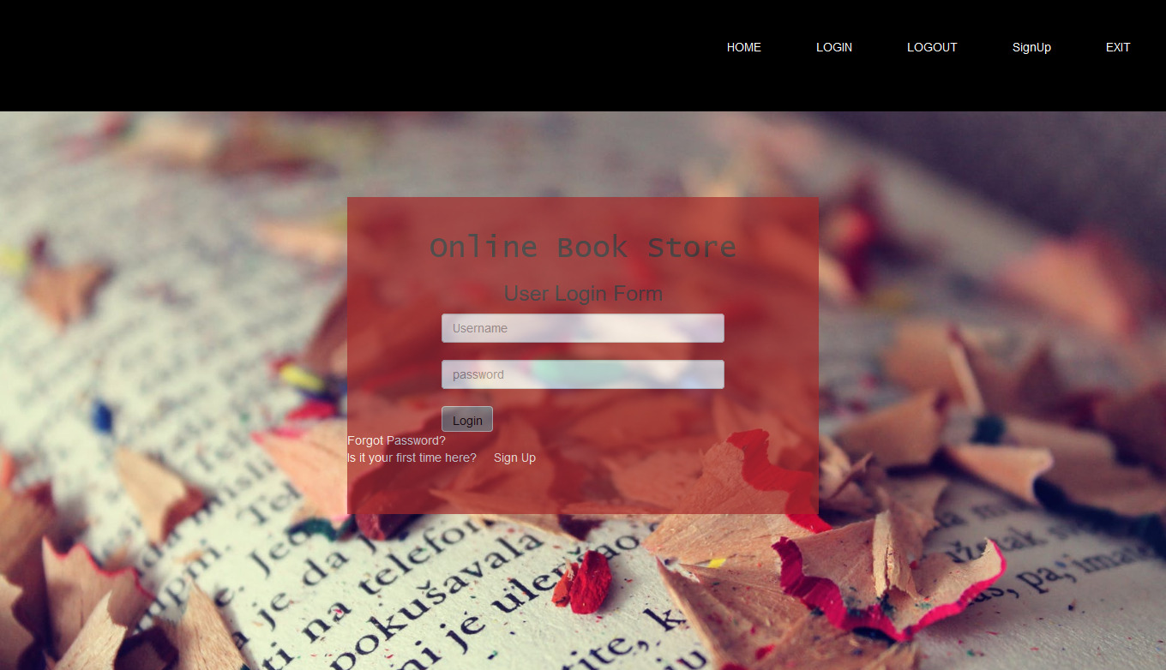
User Login Form

Slide 14
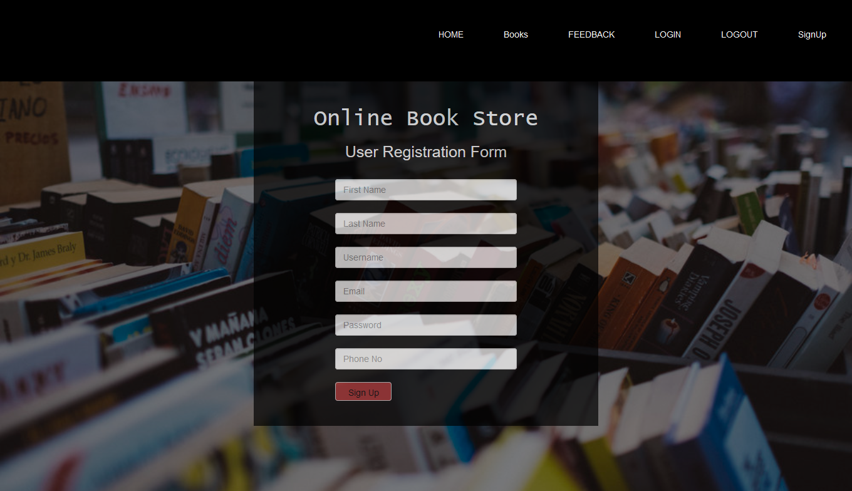
Registration Form

Slide 15
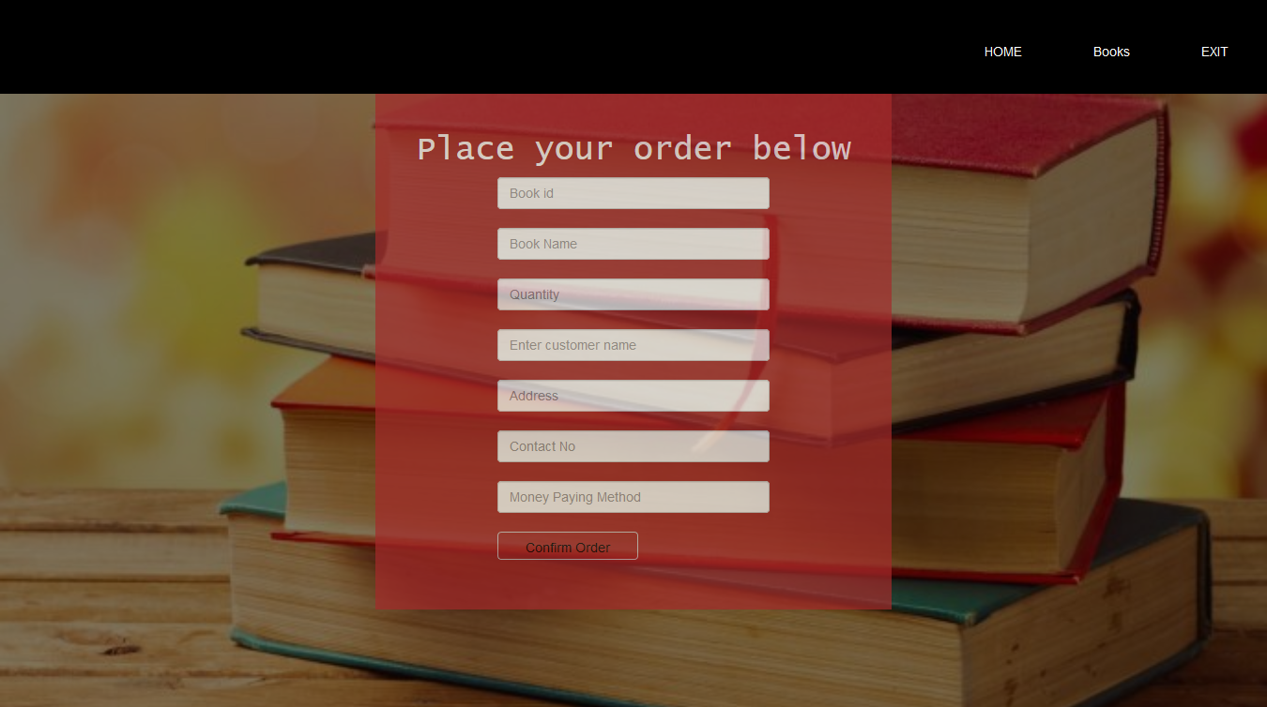
Customer can place order here

Slide 16
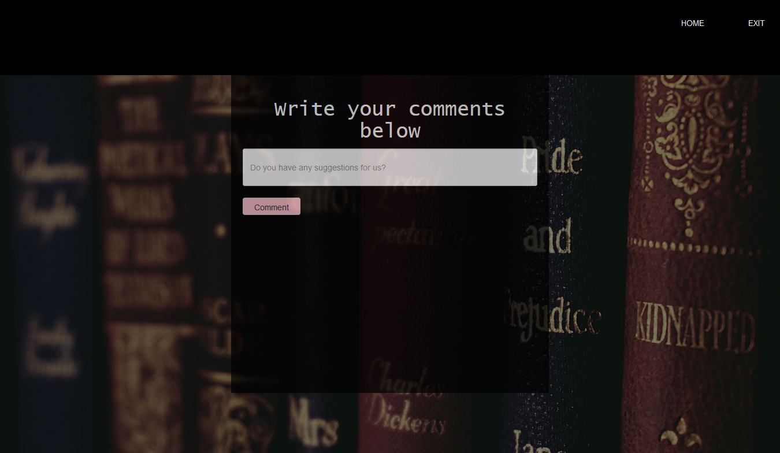
Feedback from user

Slide 17
ADMIN INTERFACES

Slide 18
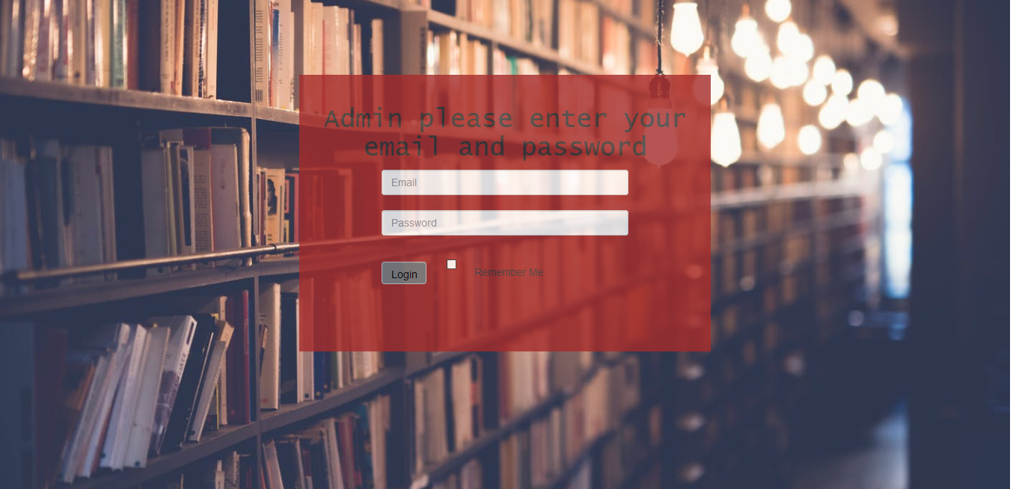
Admin Login Page

Slide 19
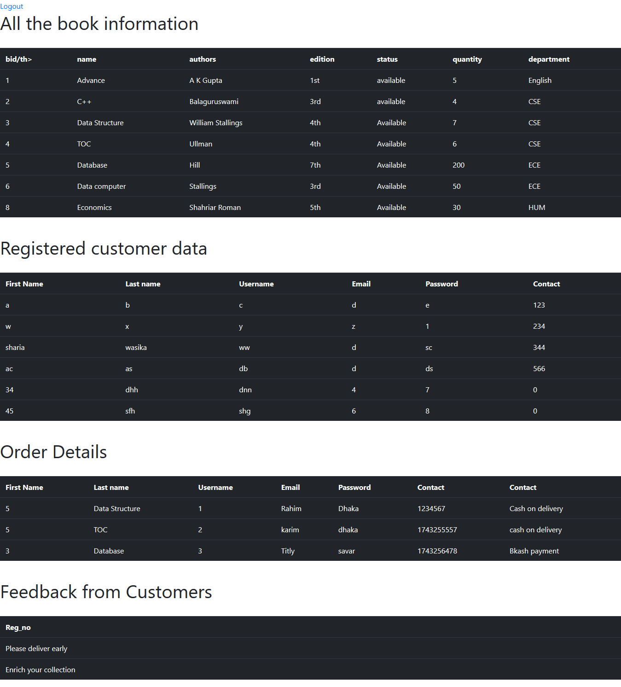
Admin only can see this page of database

Slide 20
Tools used
HTML
CSS
PHP
DATABASE
JAVASCRIPT

Slide 21
Thank you

